Slide 1
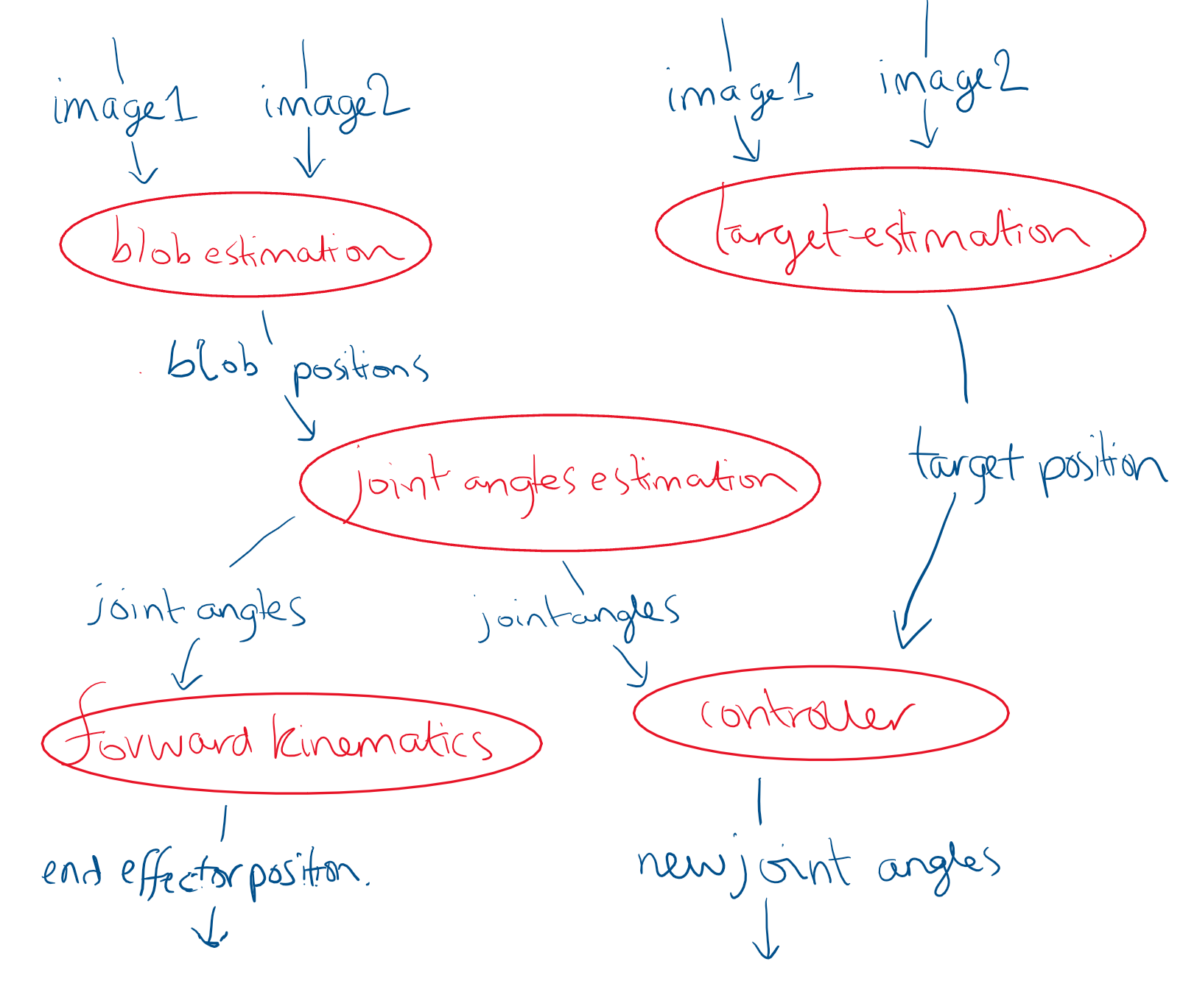
Node structure
Notes:
We have split our code into several different nodes. We have the blob estimation and target estimation nodes which get the images from the two cameras, and publish blob and target positions to a topic. (Within each of these is the functionality that was in image1.py and image2.py ). The joint angles estimation subscribes to blob positions topic and calculates joint angles, publishing them. Forward kinematics node subscribes to joint angles and publishes an end effector position. The controller subscribes to joint angles and target position and performs closed loop control to calculate the new joint angles which it publishes to make the robot move towards the target.
Why split into different nodes? The code will run faster this way, as the nodes can run on different threads. Also, it means that each node is doing a specific task, not lots of things at once. Increases readability and maintainability.

Slide 2


Target detection - method
box
Thresholding
Template matching
Position relative to base frame
sphere
Notes:
Use thresholding to keep only the orange pixels in the image, then use template matching with the sphere template to find the sphere and its position. If we wanted to find box instead would use the other template.
Find the position relative to the base frame. Explain about target history - or leave until ‘issues’ slide?

Slide 3
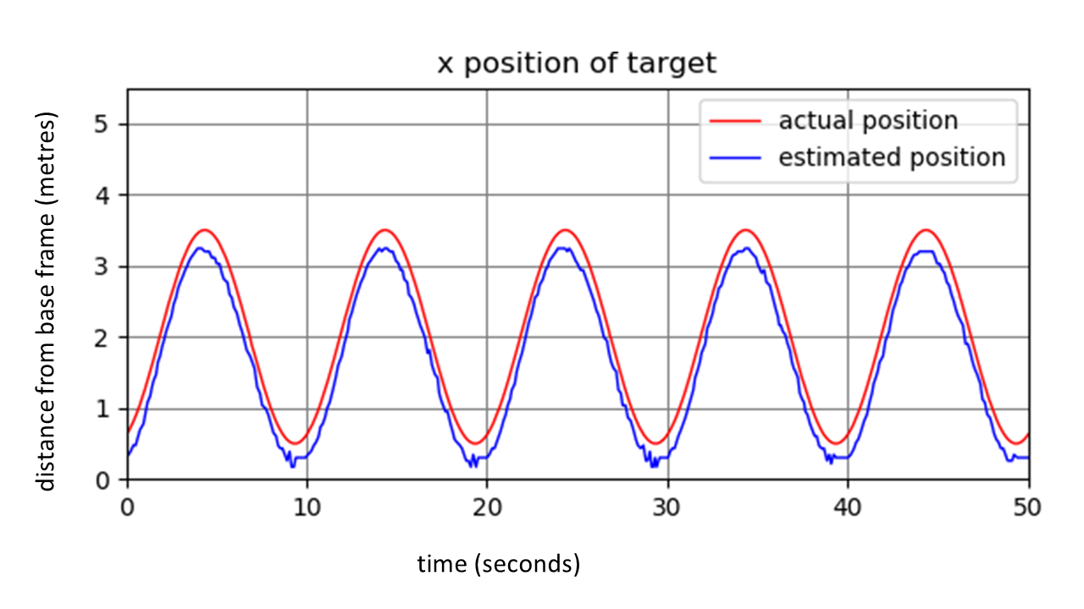
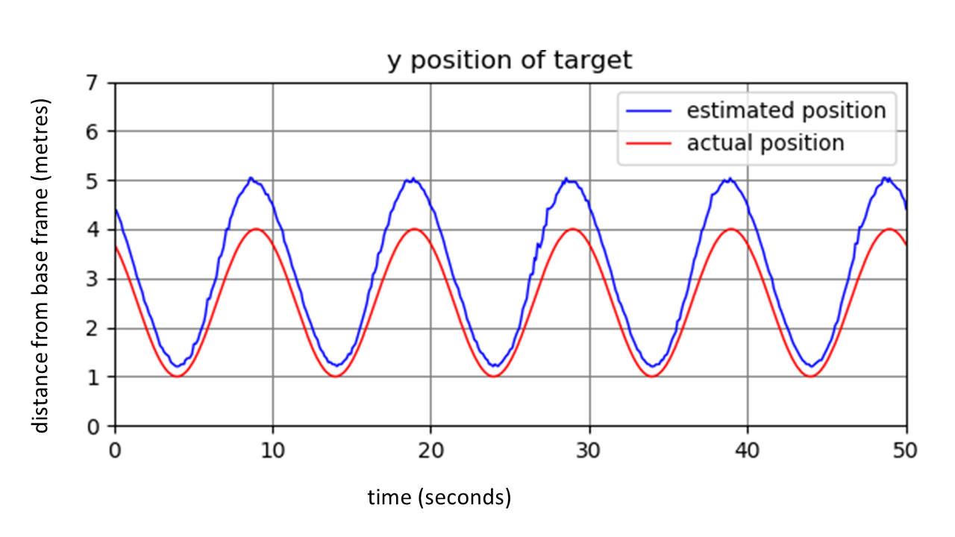
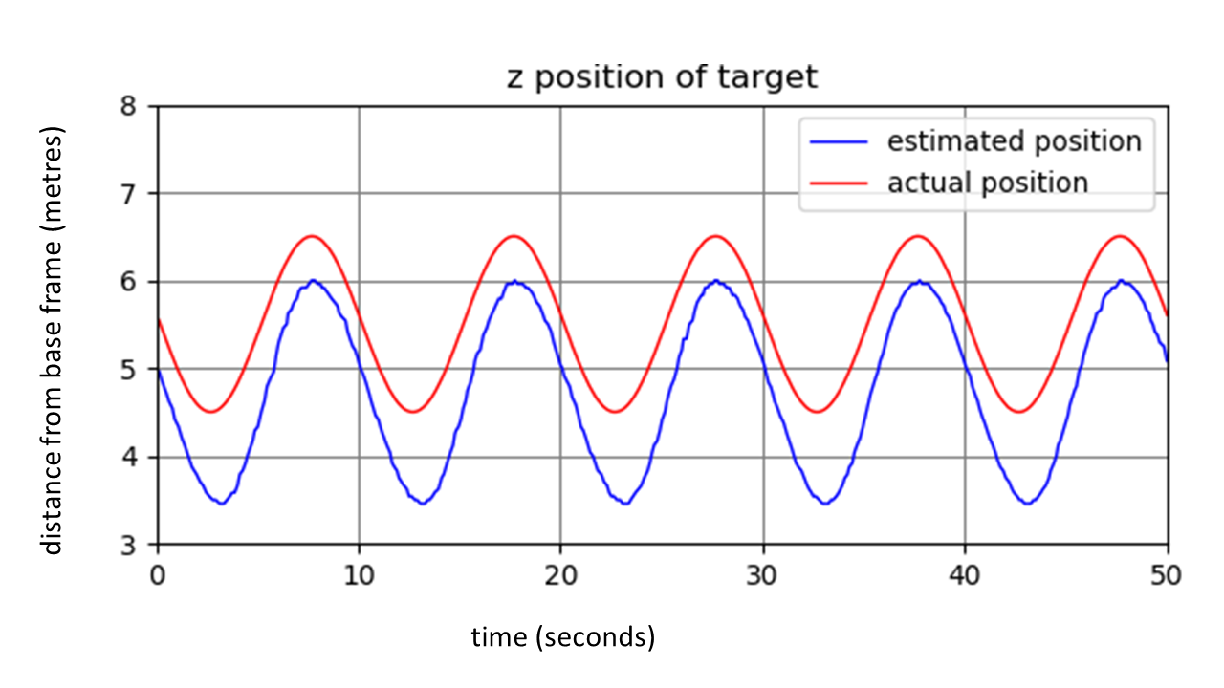
Target detection - position estimates
Sources of error?
  Distance conversion (pixels to metres) not perfect
  Sphere hidden behind links/joints
Notes:
Comparing the estimate to the actual position,we can see that our code does well. All estimates follow the sin wave pattern, in sync with the actual position. The estimates are shifted up/down a little, but are still close. The little blip you can see in the trough of the x estimated position is from when the sphere became partly hidden by a link, but you can see it didn’t make a bit impact on the estimate. Why might the estimates be a bit off? The pixel to meter conversion rate may not be perfect, causing some error.

Slide 4
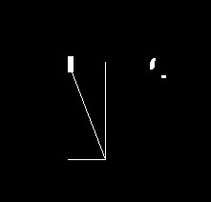
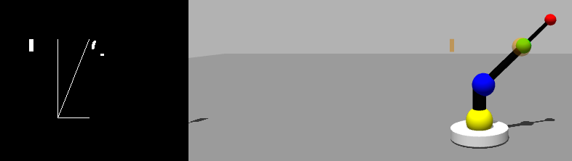
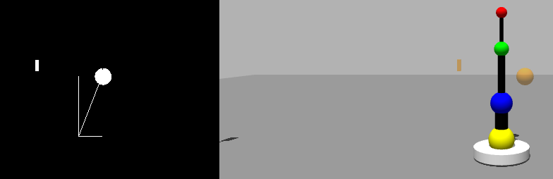
Target detection - issues resolved
When sphere hidden, estimated box instead
=> use history until in view again
When sphere overlaps green, base frame position estimate moved
=> use erosion to remove noise
before
after
live visualisation of estimate used to check correctness
Notes:
When checking our target position estimates were correct we used this visualisation of the orange mask, with lines showing the estimated x and y position, which updates in real time.
When sphere is hidden from the camera behind eg the green joint, originally the target estimate moved to the box, as it had next largest area of orange. So we set a threshold so that if the template matching result was below this threshold, then the target estimate becomes the previous target location. When the sphere comes back in view it continues as normal. This means the estimate is slightly off for a short time, compared to moving a lot to the box and back.
When the sphere goes infront of the green joint, the combination of colours results in some yellow, which was picked up in our yellow mask, and moved our base frame position estimate. This also moved the target estimate. To fix this we eroded the mask to remove noise before getting the base frame position.
The orange mask was also eroded to remove noise - but initially eroded too much that the box sometimes disappeared, so we had to reduce the level of erosion.
Eroded too much - box disappeared

Slide 5
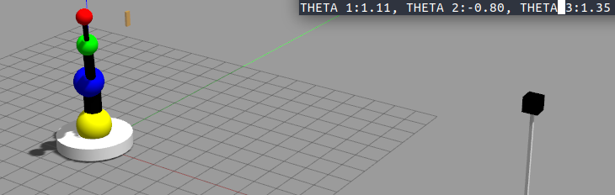
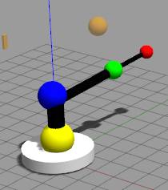
Joint angle estimation

Slide 6
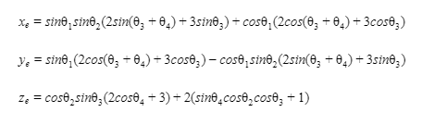
Forward kinematics

